Slide 1

Pneumonia detection using cnn

Slide 2
Abstract
Pneumonia is an infection in the lungs that inflames the air sacs in one or both lungs. It is caused by a bacteria called Streptococcus pneumonia that normally lives in the upper respiratory tract.
Chest X-ray is used by doctors to confirm the infection and its location. Thus developing an automatic system for detecting the infection can help to treat the patients quickly.
Deep Learning Convolutional Neural Networks (CNN) is the go-to algorithm when it comes to image classification. CNN models can be used to analyze and find patterns in the images.
We build a CNN model to analyze the patterns in the given X-ray image and predict the patient is infected or not.

Slide 3
Introduction
Deep learning is one of the AI techniques which makes computers learn and make things done as like how humans complete their tasks done with their intelligence. It imitates how the human brain works to process the data in detecting objects, speech recognition, translating speech, and decision making.
Deep learning is a key technology that is used for inventing driverless cars, which makes the car recognize traffic signals, to distinguish a pedestrian from a lamp-post, increasing or decreasing speed with respect to the vehicles nearby.
It is the main technology used in voice control in consumer devices like phones, tablets, smart TVs, and hands-free speakers and used in Apples Siri, Windows Cortana, etc. Now it is achieving the outcomes which were not possible in previous years.

Slide 4
Introduction
A Convolutional Neural Network (ConvNet/CNN) is one of the Deep Learning algorithms which may absorb an input image, assign importance (learnable weights and biases) to varied aspects/objects within the image and be able to differentiate one from the other.
The pre-processing required during a ConvNet is far lower as compared to other classification algorithms. While in primitive methods filters are hand-engineered, with enough training, ConvNets have the power to find out these filters/characteristics.
The architecture of a ConvNet is analogous thereto of the connectivity pattern of Neurons within the Human Brain and was inspired by the organization of the visual area.

Slide 5
Literature Survey
Previous Models on Pneumonia Detection
Neural Network for detecting whether a patient is infected or not
Convolutional Neural Network built from scratch to predict the presence of pneumonia
Studies the differences in the results when neural network and support vector machines are used in studying the trend of various age groups.
the paper establishes a diagnostic tool based on a deep-learning framework for the screening of patients with blinding retinal diseases.
presents a deep neural network based on convolutional neural networks and residual network (ResNet)

Slide 6
requirements
The required softwares and libraries required:
Jupyter Notebook for developing model
Libraries for model building: Tensorflow, Keras, Pandas, Numpy, matplotlib
Library for Front End Page: Flask
Scripting Language: Python, HTML, CSS

Slide 7
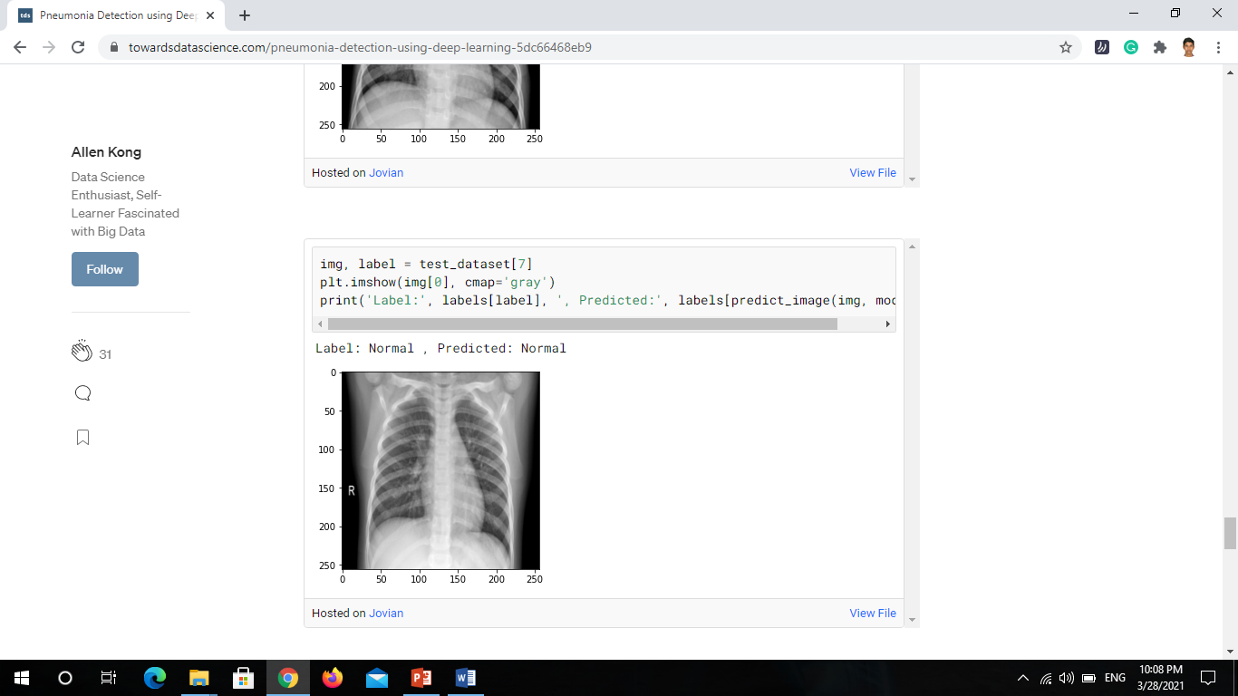
solution
The CNN model thus built will be integrated with Flask framework to be able to get the input from the user through a web page and predict whether the patient is affected by pneumonia or not.

Slide 8
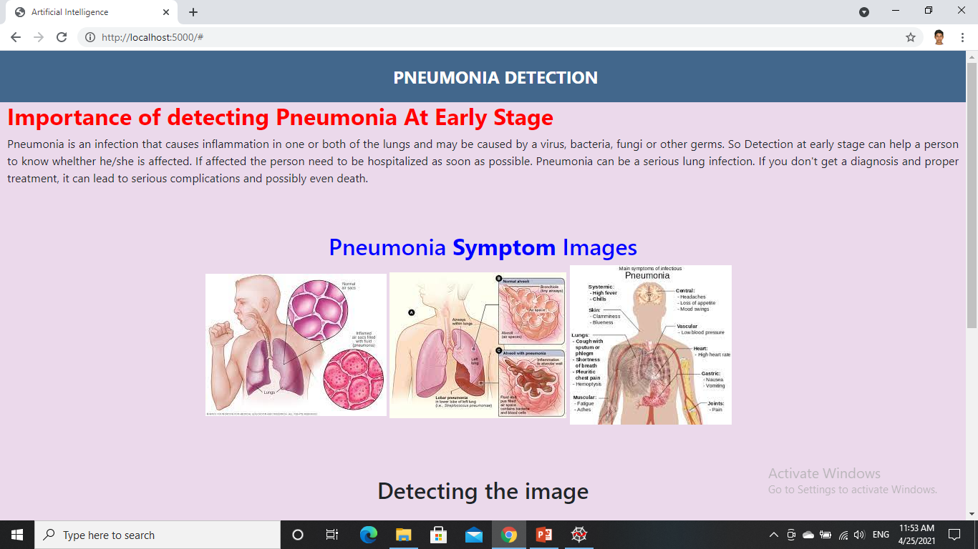
Output

Slide 9
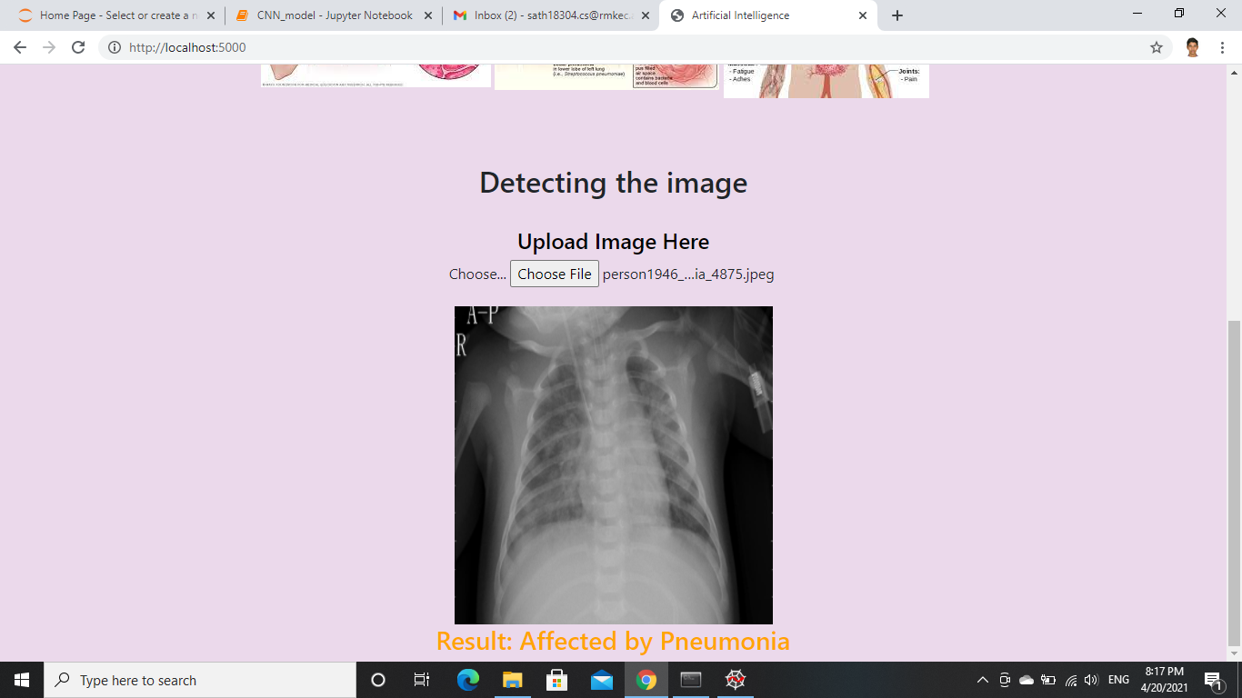
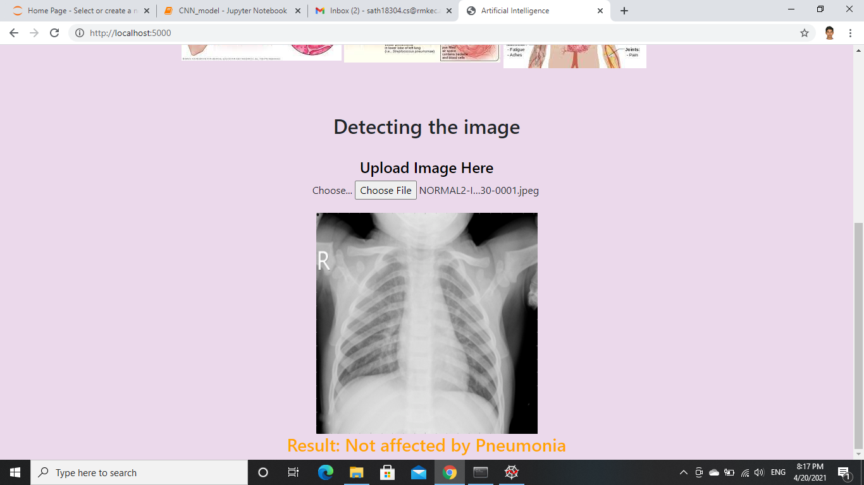
output

Slide 10

Future enhancements
The CNN model built has an accuracy of 95% but still it can be improved.
Adding more layers of convolution can make the model predict better.
The image resolution can be increased to get better results.

Slide 11
references
[1] Rajpurkar P, Irvin J, Ball RL, Zhu K, Yang B, Mehta H, et al. (2018) Deep learning for chest radiograph diagnosis: A retrospective comparison of the CheXNeXt algorithm to practicing radiologists. PLoS Med 15(11): e1002686. https://doi.org/10.1371/journal.pmed.1002686
[2] Okeke Stephen, Mangal Sain, Uchenna Joseph Maduh, Do-Un Jeong, "An Efficient Deep Learning Approach to Pneumonia Classification in Healthcare", Journal of Healthcare Engineering, vol. 2019, Article ID 4180949, 7 pages, 2019. https://doi.org/10.1155/2019/4180949
[3] Begg, R. ‘A Comparison of Neural Networks and Support Vector Machines for Recognizing Young-Old Gait Patterns’ ISBN: 0-7803-8162-9 Published in: TENCON 2003. https://ieeexplore.ieee.org/document/1273344
[4] Daniel S. Kermany, Michael Goldbaum, Wenjia Cai ‘Identifying Medical Diagnoses and Treatable Diseases by Image-Based Deep Learning’ Cell VOLUME 172, ISSUE 5, P1122-1131.E9, FEBRUARY 22, 2018. https://doi.org/10.1016/j.cell.2018.02.010
[5] Kalyani Kadam, Dr.Swati Ahirrao, Harbir Kaur ,Dr. Shraddha Phansalkar ,Dr.Ambika Pawar ‘Deep Learning Approach For Prediction Of Pneumonia’ INTERNATIONAL JOURNAL OF SCIENTIFIC & TECHNOLOGY RESEARCH VOLUME 8, ISSUE 10, OCTOBER 2019 ISSN 2277-8616

Slide 12

Thank You

